Slide 1
Duke Ignite Workshop
Gradient Descent, Perceptron, Neural Networks

Slide 2

About Me
Junior at Duke
CS/Math Major
Interested in ML, SWE, Finance

Slide 3
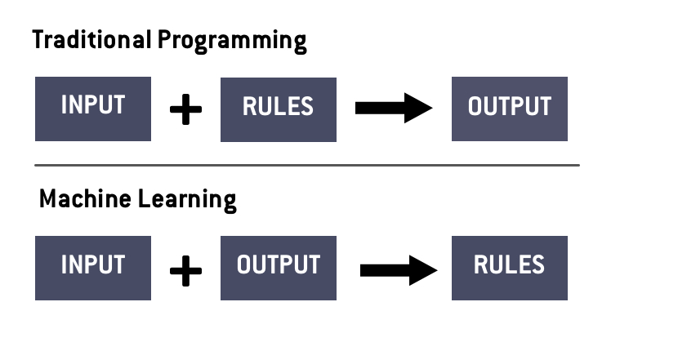
Introduction
Machine learning is all about finding trends in data, and extrapolating those trends for real world solutions. The goal is to make a model “learn” by giving it data, making it take a “guess”, and correcting its “learning” based on that guess

Slide 4
Types of Machine Learning
There are many different forms of machine learning, but the main two superclasses are
Supervised Learning
You are given the input and the output, and your goal is to determine the correlation. Working with labelled data
Unsupervised Learning
You are given the input, and the goal is to cluster or group this input. The data does not have a given label and your goal is to more determine the labels

Slide 5
Train/Validate/Test
The main process for a standard supervised learning model comes in three steps
Train - This is the process where the model “learns”. The input data is given to the model, and it processes this data row by row, produces an output, compares this output to the expected output, and updates the parameters of the model
Validate - This is the part of the dataset that is used to determine how well the model is doing during training. It is not used to adjust the parameters, but instead more global variables such as how fast we train or how big of a jump we make in minimizing
Test - This is unseen data that is used to evaluate the model. In literature, the accuracy or score of this model is the one reported and used as the “true” performance of the model

Slide 6
Terminology
Parameters - These are the weights of the model, the numbers we will use to do our calculations
Hyperparameters - More global variables that do not change in a single model such as input size, output size, hidden layer size, etc.
Batch - A subset of the training data that is used for one iteration of training
Epoch - A collection of 1 or more batches where all the the train data is eventually passed through the model

Slide 7
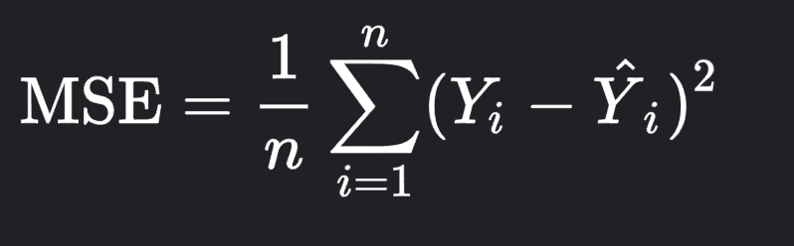
The Loss Function
The goal is to minimize this loss function

Slide 8
Gradient Descent

Slide 9
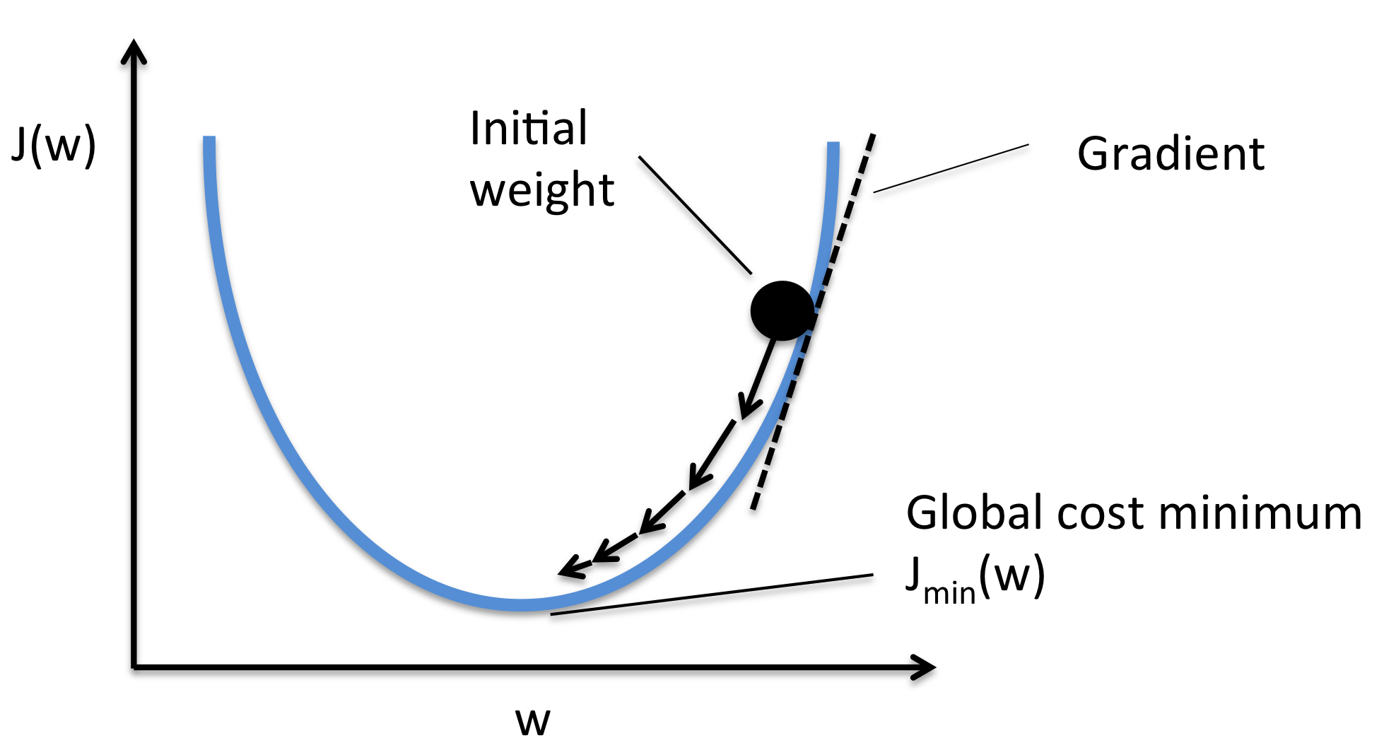
What is a Gradient?
In multivariable calculus, the gradient is a vector in the direction of the steepest slope.
Imagine our loss function as a curve in a 3D space. If we keep moving in the direction of the gradient, we will reach the minimum loss

Slide 10
Try This!
https://uclaacm.github.io/gradient-descent-visualiser/#playground

Slide 11
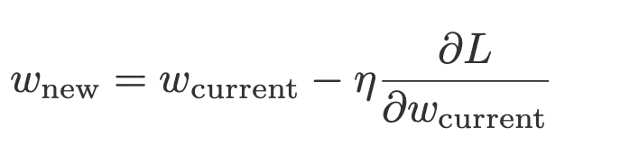
Updating the Weights
The process of updating the partial derivatives and updating the weights is called backpropagation

Slide 12
Perceptron

Slide 13
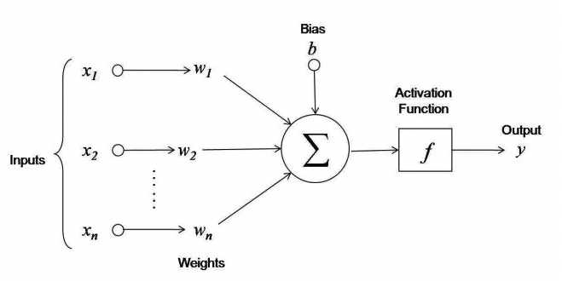
The Perceptron
Each input variable is multiplied by a weight and added together with a bias term
This output value is then put into an activation function

Slide 14
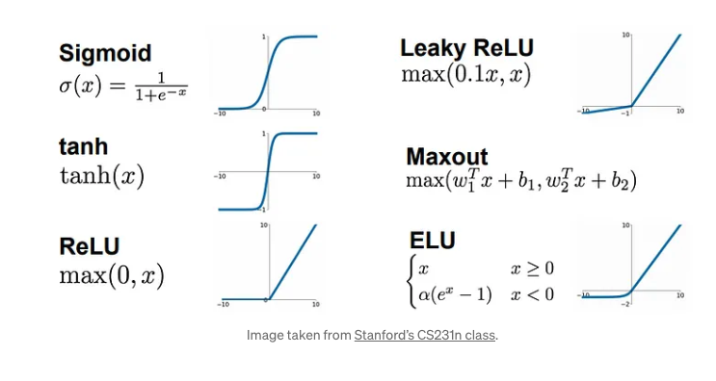
Activation Function
Adds nonlinearity to our output
Without it, adding more layers to a network would mean nothing

Slide 15
Forward Propagation
2
5
1
3
???
-3
1
2
4

Slide 16
Forward Propagation Solution 1
2
5
1
3
???
-3
1
2
4
19
19

Slide 17
Forward Propagation Solution 2
2
5
-2
0
1
3
???
-3
1
2
4
19
19

Slide 18
Forward Propagation Full Solution
2
5
-2
0
1
3
38
38
38
-3
1
2
4
19
19

Slide 19
Back Propagation
2
5
-2
0
1
3
38
38
38
-3
1
2
4
19
19
What is . What about

Slide 20
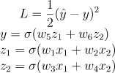
Back Propagation Formulas

Slide 21
The Neural Network
Also known as the multilayer perceptron

Slide 22
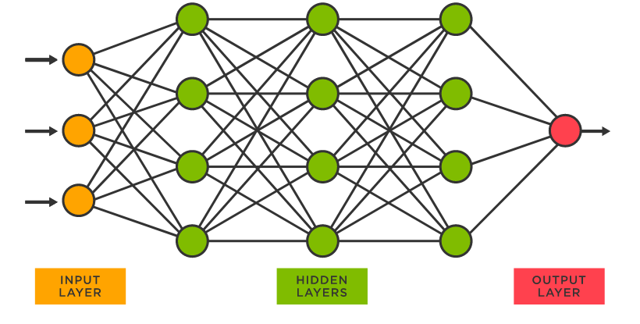
The Neural Network
The simplest neural network is just a collection of perceptrons
Consists of an input layer, hidden layers, and an output layer
Same loss function and goal, minimize the loss function

Slide 23
Working with Neural Networks
Refresher: There is a train set, a validation set, and a test set
1st: Randomly split your dataset into these three sets, usually with a 60-20-20 split
Fit the model with the train data and use the validation data as intermediate benchmarks
Report the findings of the unseen test data

Slide 24
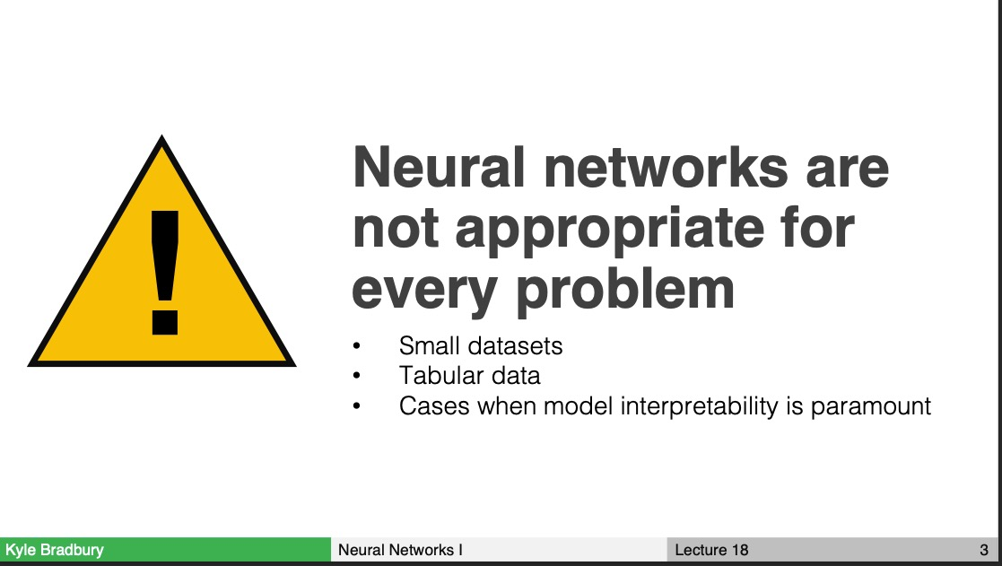
https://kylebradbury.github.io/ids705/syllabus.html

Slide 25

Working with the Notebooks
I recommend doing everything locally (easier)
Install Anaconda (https://www.anaconda.com/)
conda create -n dukeignite python=3.7
conda activate dukeignite
pip install -r requirements.txt

Slide 26

Now You Try!!

